Slide 1
Accessing the Curriculum for diverse Learners
Contemporary Functional Life Skills

Slide 2
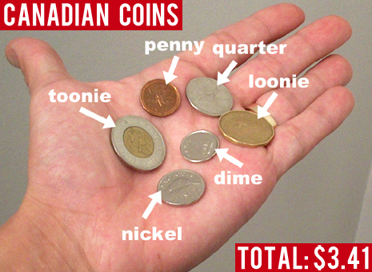
Numeracy: money skills
Recognition
Value: coins and bills
Purchasing
Banking
Budgeting
Credit
ATM’s
What else?

Slide 3

Numeracy: money skills
Many adaptations and / or strategies to increase students’ abilities to use money for purchases
Real opportunities (not just simulation) increases learning and generalization

Slide 4
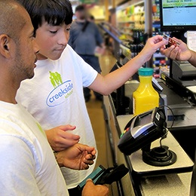
Activity: Purchasing items
Envelope with predetermined amount of money for a purchasing exchange
“More-than-one” technique
Selecting lower priced item
“Enough money” strategy

Slide 5
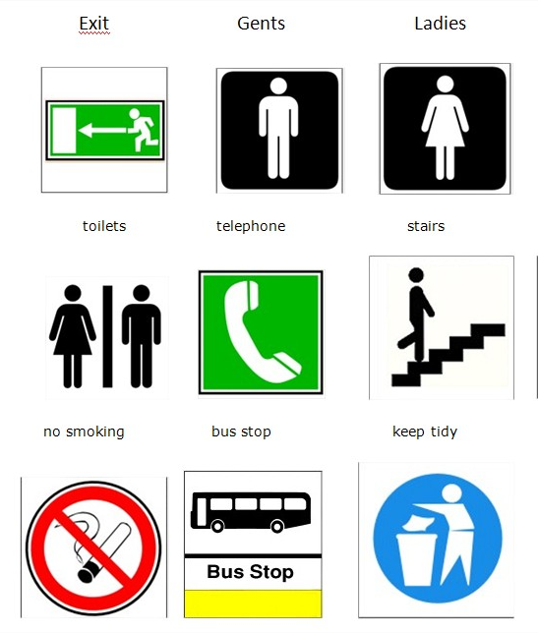
Functional Life Skills
1970’s to 1990’s
First options for students with severe disabilities to live and work in the community
Task analysis for domestic and vocational tasks
Sight words & identifying coins
Often promotes a separate curriculum

Slide 6
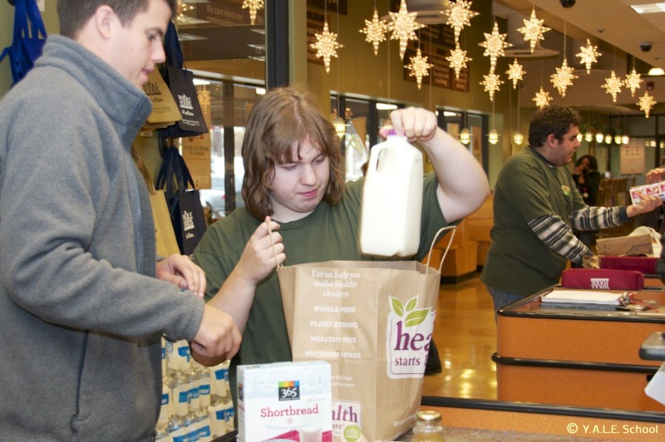
Functional Life Skills
1990’s-2000’s
Community based instruction
Integration for some students, grade and courses at high school
Social integration
Expectation for learning
Adaptations and modifications

Slide 7
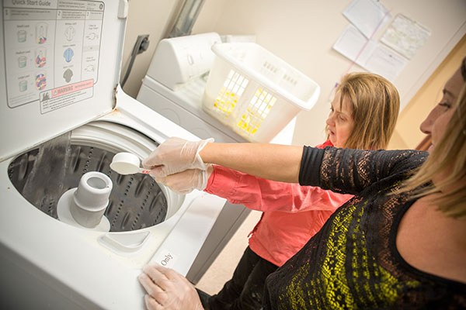
Original definition
Variety of skills need in natural domestic, vocational and community environments
Who would perform the activity?
Promoted transition for adolescents
Contribute to functioning in adulthood

Slide 8
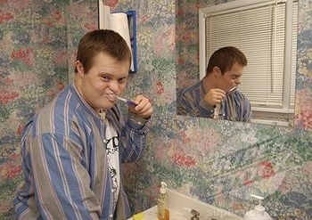
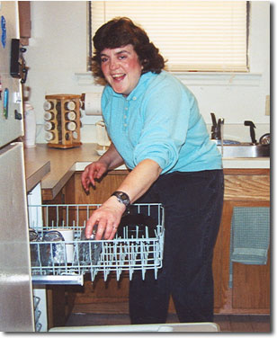
Traditional Life Skills

Slide 9
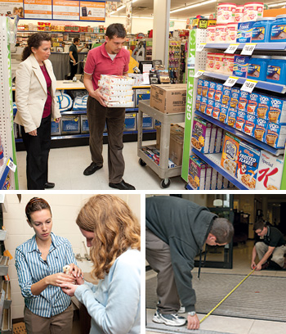
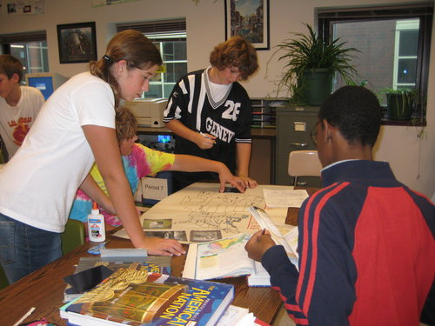
Contemporary Life Skills

Slide 10

Contemporary Life Skills
Expanded to include:
Academic skills
Technology skills (including assistive devices)
Communication skills
Social and interpersonal skills
Thinking strategies

Slide 11
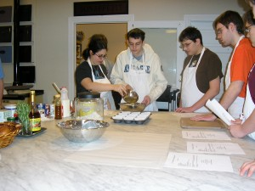
Contemporary Life Skills
Broad clusters:
Academics
Communication and Social Skills
Domestic living
Employment / Post secondary education
Community Inclusion
Recreation and leisure
Self care

Slide 12
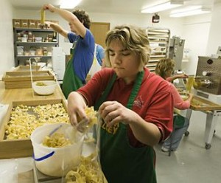
Contemporary Life Skills
What skills are needed by this individual to access opportunities for enhanced community participation and quality of life?

Slide 13
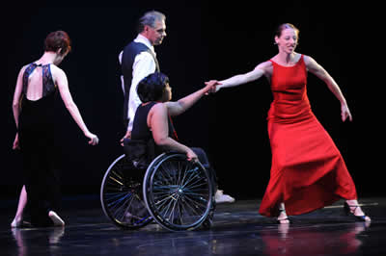

Contemporary Roles

Slide 14
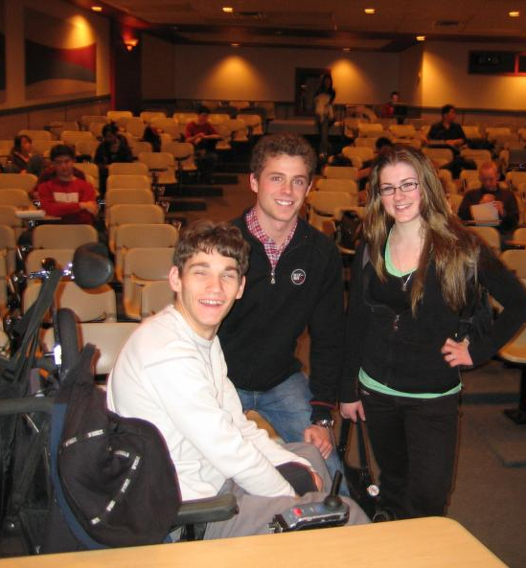
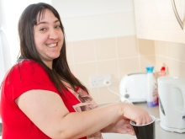
Contemporary Roles

Slide 15
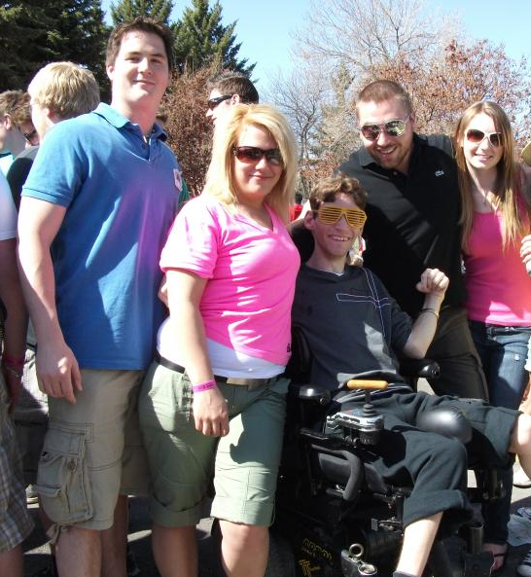
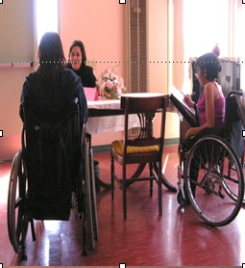
Contemporary Roles

Slide 16
Alternative Definitions
Evidence based practices for teaching academic skills combined with community skills to facilitate the transition process from high school to adult life for individuals with cognitive or physical disabilities. These skills should be directly linked to post-school outcomes like post secondary education, employment, independent living and community involvement. (Sharon Link)

Slide 17
Alternative Definition (Maryland Coalition)
IEPs with:
General education goals
Communication or social skills
Job skills
Skills that increase the student’s self-advocacy or participation as a learner in school and
Other skills as functional

Slide 18
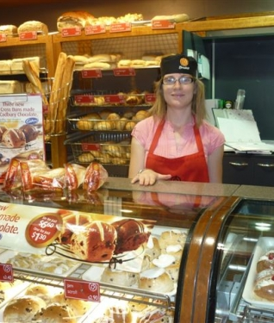
Other skills as functional
Age appropriate
Required now
Required as an adult
Usefulness

Slide 19
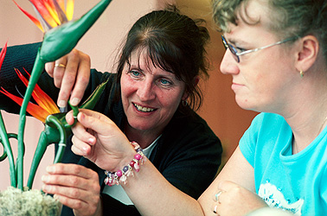
Other skills as functional
Student and family preferences
Enhancement of the student’s status
Expands community participation
Probability of acquisition

